Slide 1


Volunteers - Empowering the whole community to be the solution!
Edwin C. Kline
MCM Emergency Planner
Delaware County Emergency Services

Slide 2

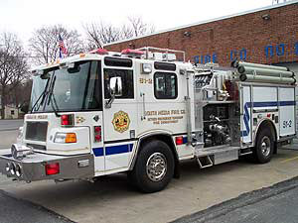

A little about me…
MCM Emergency Planner for the Delaware County Emergency Services since January 2021.
Volunteer Management Coordinator, September 2011 to June 2021. CERT instructor since 2004.
Firefighter and emergency medical technician in Delaware County since 1987.
Have served in the positions of Training officer, Lieutenant, Captain, Assistant Chief, and Chief of Department.
Previously employed for 6 years as a certified Police, Fire, EMS dispatcher for the County of Delaware, Pa
Previously employed for 20 years as a Police Officer with the Swarthmore Borough Police Department.
A.A.S. Emergency Management & Planning, D.C.C.C.
B.A. Liberal Studies, Neumann University
MBA (in progress) Eastern University

Slide 3
Volunteers - Empowering the Whole Community to be the Solution!
Objectives:
Develop an understanding of our pre-pandemic situation
Discuss and review pandemic response - including non-pharmaceutical and pharmaceutical operations
Expand on areas of improvement to sustain whole community
Propose community resiliency through all hazard's response planning

Slide 4
Defining: Volunteers
An act of an individual or group freely giving time and labor for community service. Many volunteers are specifically trained in the areas they work, such as medicine, education, or emergency rescue. Others serve on an as-needed basis, such as in response to a natural disaster.
To promote information-sharing and mutual understanding among partners and provide guidance on integrating activities across various subject areas and the full disaster life-cycle. This work empowers stakeholders and communities to strengthen their capabilities, capacity, and delivery of inclusive, equitable services.

Slide 5
Defining: Volunteers
Volunteers are NOT a liability; they ARE capability and capacity that you need but cannot afford!
Volunteers can come from every corner of your jurisdiction.

Slide 6
Defining: Whole Community
The Nation cannot be strong if the communities that comprise it are vulnerable to the effects of the threats and hazards that it faces. Whole community is a focus on enabling the participation of a wider range of players from the private and nonprofit sectors in order to foster better coordination and working relationships.

Slide 7
Defining: Whole Community
“Everyone” is the easy way out
*Underserved populations that do not have adequate access to medical care. This includes rural, elderly, low-literacy, blue collar, and poor
People living with Access and Functions Needs
**Social vulnerabilities - potential negative effects on communities caused by external stresses on human health. Such stresses include natural or human-caused disasters, or disease outbreaks.
People living in crisis everyday
Roof, water, food may be the only priorities
May not trust government
*National Institute of Health
**CDC (SVI)

Slide 8
You have heard this before…
Lead, follow, or get out of the way!
You are either part of the solution or you are part of the problem!

Slide 9
Acknowledgement
- Nothing happens in a vacuum
- Please know how important you are to the success of everyone around you.
Pa Department of Health
Pennsylvania CMHD with MRC Units
  Allentown
  Bethlehem
  Allegany County
  Bucks County
  Chester County
  Delaware County
  Erie County
  Montgomery County
  South Central PA (York County)
  Philadelphia
Additional County-Municipal Health Departments
  Wilkes-Barre
All of us did some extremely great things to overcome the challenges presented by COVID 19.
For the past 11 years our program has learned so much from each of you!
When I started, I did not even know what the MRC was, or much about public health.
YOU – have been a great example to me and certainly have made a difference through your own programs.
This is our story…

Slide 10
Ask yourself these questions?
Was your jurisdiction prepared for COVID 19?
What was missing in your pre-pandemic planning?
What was your strongest asset at the beginning?
What ways do you produce a non-pharmaceutical response?
A pharmaceutical response?
Did you use your MCM plan?
What became the backbone of your response?
When did you really start serving the Whole Community?
Did it go well?
What improvements do you plan to make?
How will it go next time?

Slide 11
What was your role in the response?
  Reduce deaths
  Provide PPE
  Provide education
  Meet human unmet needs
  Provide testing
  Increase hospital beds
  Increase ventilators
  Provide vaccine
  Increase staff/volunteers
  Respond to the whole community
What were your objectives?
What goals did you have to meet those objectives?
What measures were in place to measure your progress?
What successes have you celebrated?

Slide 12
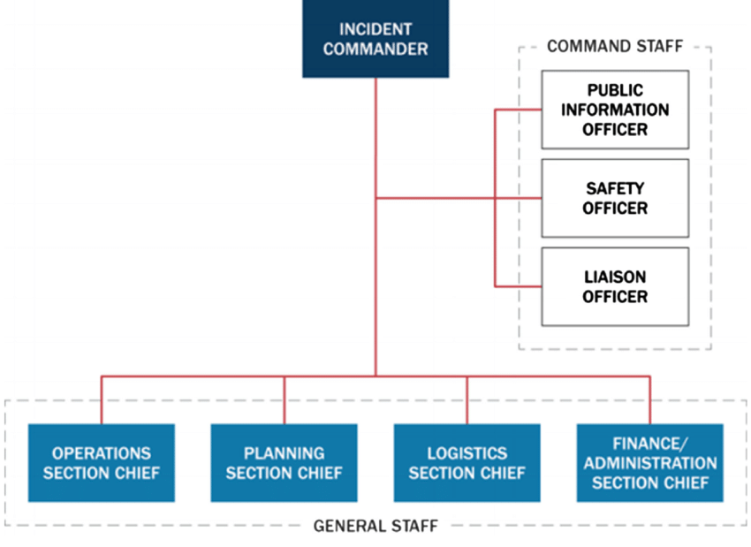
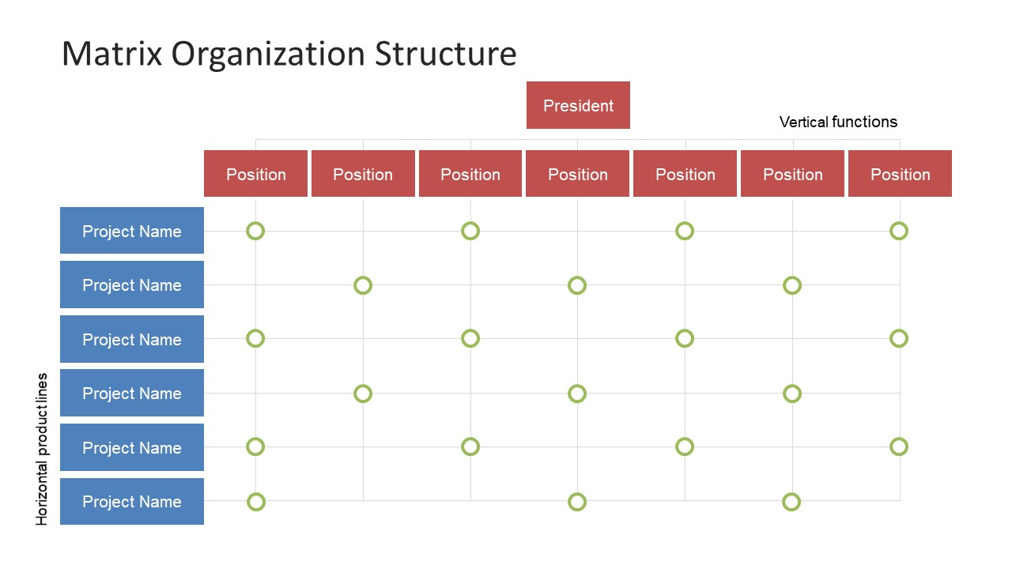
What management system did you use?
Standard Line Management
Matrix

Slide 13
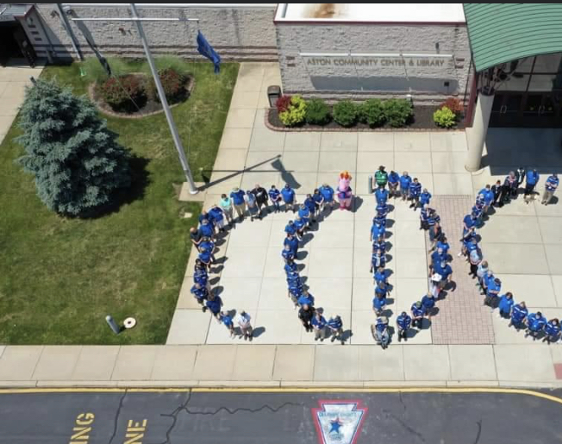
Delaware County
Pre-pandemic Situation

Slide 14
Delaware County
Pre-pandemic Situation
Intercommunity Health Coordination
Department of Human Services
Department of Emergency Services
Shared Medical Countermeasures (MCM) Program
“Established” under CDC Guidelines
Mass Care program integration
Citizen Corps of Delaware County (CCDC) Umbrella
  MRC, CERT, CART, ARES, Red Cross, Salvation Army and many more NGO’s and VOAD groups.

Slide 15
Delaware County
Pre-pandemic Situation
Recruiting and outreach
Training – training – training
Food drives and dispensing operations
September 2015 Papal visit tests MRC capacity
Mass care responses – reception centers and shelter operations
Floods, fires, wind, and FLU CLINICS
October 31, 2019 – Tornado
November 2, 2019 – Ephrata MCM Full Scale Exercise
2019 – CCDC volunteers participated 2,740 times over 275 events, giving 7,622.15 total hours.
Spring 2020 Vaccination training and exercises planned

Slide 16
Response to COVID 19 without a Vaccine
Non - pharmaceutical operations
Separation - the move to Glen Mills School (GMS).
PPE Distribution – for 1st responders. Ebola PPE.
1st Responder Refuge. Month long, CCDC staffing
Volunteer Reception Center (VRC)
  CCDC grew from about 500 to about 3,000.
Supported call centers (Montco, Chesco, Delco)
Coordinating Alternate Care Site venue, equipment, staffing, and wrap around services.
COVID 19 testing operations
Chamber of Commerce to distributing PPE to business.
Feeding the public
  Conducting feeding coordination calls with regional and county resources, and local food pantries
  Identified unmet needs
  Shared resources
  Deploy CCDC for Meals on Wheels, Food pantries, diaper distro
Support of election operations
Support testing results crew
ARES and DelCART operations
Continued orientations, MCM training

Slide 17
TIMELINE
3 March 2020
initial response to COVID 19 begins with 1st Responder PPE distribution, move from 911 Center on 16 March
19 March 2020
Opening of CCDC Volunteer Reception Center (VRC)
20 March 2020
Opening of First Responder Refuge at the Glen Mills School, run by about 300 CCDC till 13 April
2 April 2020
Preparations for the regional Alternate Care Site (ACS) begin
9 April 2020
Feeding coordination and support begins with Meals on Wheels, 21 April Loaves & Fishes, 13 June food drives
20 May 2020
COVID Testing begins – Upper Darby 249 tests in 12 hours

Slide 18
TIMELINE
5 June 2020
First PPE Distribution for Businesses
3 August 2020
Hurricane Isaias strikes, flooding Darby and Upper Darby.
4 January 2021
Initial meeting of the Delco COVID 19 Task Force
6 January 2021
Initial Data Crew Mission begins. Later becomes the call center.
14 January 2021
First VPOD operations at the 911 Center. Support of COVID 19 Testing and Food Pantries soon ends
20 Jan. 2021
Aston VPOD opens 6 hours = 130 doses. Busiest day: 15 May, 1309 doses, 70,132 total doses

Slide 19
TIMELINE
27 Jan. 2021
Delco Wellness Center in Yeadon VPOD opens
29 Jan. 2021
New staff begin to operate VPODS
31 Jan. 2021
741 citizens join CCDC in January
8 Feb. 2021
CCDC begins supporting VPODs at DCMH and CCMC
25 Feb. 2021
Keystone First in Chester VPOD opens
26 Feb. 2021
Penn Medicine in Radnor VPOD opens
31 Feb. 2021
336 citizens join CCDC in February
14 Mar. 2021
Upper Darby High School VPOD first doses (AFN)

Slide 20
TIMELINE
15 Mar. 2021
Springfield Hospital VPOD opens
29 Mar. 2021
Homebound / Homeless program begins
31 Mar. 2021
over 40 staff are working, 507 CCDC volunteers joined in March.
10 Apr. 2021
Delaware County Community College drive through VPOD opens
21 Apr. 2021
Mercy Fitzgerald drive through VPOD opens
24 Apr 2021
Radnor High School VPOD first doses
2 May 2021
Ridley High School VPOD first doses
5 May 2021
Delaware County Prison begins dispensing

Slide 21
TIMELINE
13 May 2021
69th Street Terminal VPOD opens
17 May 2021
POP UP VPOD operations begin
19 May 2021
Pediatrician support begins
17.6 % fully vaccinated
3 June 2021
COMMUNITY events begin
5 June 2021
Aston VPOD closes
30 July 2021
Springfield VPOD closes
31 July 2021
Keystone Wellness in Chester VPOD closes
54.5% fully vaccinated

Slide 22
TIMELINE
9 August 2021
Homebound restarts once per week
13 September 2021
Begin TESTING again
25 September 2021
Chester site re-opens
30 September 2021
69th Street vaccinations begin again
11 December 2021
Expand vaccinations hours or operations
6 December 2021
Operations Section of Task Force re-established
27 December 2021
Huge swell in COVID 19 Testing
62.4 % fully vaccinated

Slide 23
TIMELINE
January 2022
CCDC begins to assist Emergency Department staffing
10 January 2022
New staff for DCHD come onboard, orientation, education
1 February 2022
Task Force operations turned over to DCHD staff
64.4% fully vaccinated
7 February 2022
Delco MCM Staff office created
8 March 2022
MCM Re-focused on planning and preparedness
3 May 2022
Elected officials and Executive Leadership Decision Making Exercise
15-16 June 2022
MCM Full Scale Exercise

Slide 24
COVID 19 RESPONSE BY THE NUMBERS
As of February 15, 2022
  County Vaccination: 170,971 doses
  Total in county: 904,261 doses, 64.3 % fully vaccinated, 81% partially
Volunteers: 3,214 in ServPA (January 2022)
Participating volunteers: 1,469 (94% of staff are volunteers)
Task Force staff: 93 (include county employees and temporary staff)
CCDC Hours: Over 100,000
Five fixed sites, Community, Pop-Up, Homebound, Homeless
Total VPODs: 693
Supported VPODs: 149
Homebound: 4,095 doses

Slide 25
REQUIRED TRAINING – ALL
CCDC Orientation & Handbook
NIMS 100, 200, 700, 800
CCDC Emergency Preparedness & Response
MCM 101 – pill-based response
MCM 102 – vaccine-based response
You Call the Shots, Vaccine Storage & Handling – Jan 2021
Bloodborne Pathogens
HIPAA Training

Slide 26
REQUIRED TRAINING - CLINICAL
CDC Moderna COVID Vaccine Standing Orders for Administrating Vaccine
CDC Vaccine Preparation and Administration Summary
CDC Pre-vaccination Checklist for COVID 19 Vaccine
FDA Fact Sheet for Recipients and Caregivers
CDC You call the Shots: Module 18 – Vaccine Administration
Cool Cubes use and operations
CDC V-Safe
FDA Emergency Use Authorizations
CDC Clinical Considerations
CDC Recipient Education
CDC Training & Education

Slide 27
ADDITIONAL TRAINING
MCM Screening & Dispensing
MCM POD operations
MCM Immunization
Situational Awareness and Self Defense
Leader Communication Skills
Course of Action Development
Damage Assessment training on-line
ReDI Volunteer Management
Portable radio communications

Slide 28
ADDITIONAL TRAINING
Red Cross Sheltering Fundamentals
Red Cross Mass Care Logistics
Psychological First Aid
DCORT/CISM referrals
Fire Safety
Stop the Bleed
CPR
First Aid
Flu clinic operations and exercise
Traffic control safety

Slide 29
LEADERSHIP GUIDELINES
Positive and pro-active
Flexibility
Authority with responsibility
Written projects with SMART objectives, adjust as needed to fit program plan
Re-direct and encourage
Pause for strategic planning
Catch staff/volunteers doing things right
Happy staff/volunteers keep clients happy
Make sure everyone goes home the way they arrived
Make sure they want to come back

Slide 30
C19 TASK FORCE
COMMAND
STRUCTURE
Public Health Lead
J Casner
Medical Advisor
Dr. O’Mahony
Vaccine Planning & Dispensing
R Halt
External Affairs
R Halt
Vaccine Planning
L. Devlin
Logistics
T Morgan
Operations
E Kline
Communications
A Marofsky
Stakeholder Communications
R Halt
Public Information
A Marofsky
SOP Documentation
E Kline
Clinical
C. Sullivan
Electronic Platform
F Bilotta
Data
D Kohler
Site Selection
L Devlin
Vaccine Suppy Acquisition
L. Devlin
Vaccine Supply Distribution
T Morgan
Dispensing
E Kline
Administrative Support
Pending
DES Liaison
T Boyce

Slide 31
C19 OPERATIONS
STRUCTURE
LEAD SITE MANAGER*
YEADON SITE MANAGER* X2
GREETING LEAD
REGISTRATION LEAD
MEDICAL SCREENING X2
IDENTIFICATION CHECK X2
APPOINTMENT ENTRY X4-8
SITE CLINICAL LEAD*
IMMUNIZERS X4-8
SAFETY OFFICER
POLICE / SECURITY*
CHESTER SITE MANAGER* X2
SPRINGFIELD SITE MANAGER* X2
OPERATIONS SECTION CHIEF*
ADMINISTRATIVE ASSISTANT*
CREDENTIALING / TRAINING*
LOGISTICS SECTION CHIEF*
PLANNING SECTION CHIEF*
FLOW X2
FLOW X2
MEDICAL CONSULTS X2
RELIEF . BREAKS
OBSERVATION / POST - VACCINATION
OBSERVATION X2
FLOW
EXIT
POP UP SITE MANAGER* X2
COMMUNITY PROGRAM MANAGER*
OBSERVATION X2
Anaphylaxis
EMS
PA SIIS X2-4
CLINICAL SITE LEAD
POP UP SCHEDULER
CLINICAL CREW X2
NON MEDICAL CREW X3-4
COMMUNITY SCHEDULER
CLINICAL & NON CLINICAL CREW
HOMEBOUND PROGRAM MANAGER

Slide 32
C19 VACCINATION OPERATIONS
Aston |  |  | Aston |  |  | Aston |  |  | Aston
Start Time | 10:00 |  | Start Time | 10:00 |  | Start Time | 10:00 |  | Start Time | 10:00
End Time | 19:00 |  | End Time | 19:00 |  | End Time | 19:00 |  | End Time | 19;00
Hours | 9 |  | Hours | 9 |  | Hours | 9 |  | Hours | 9
1st dose | 0 |  | 1st dose | 237 |  | 1st dose | 215 |  | 1st dose | 205
2nd dose | 945 |  | 2nd dose | 963 |  | 2nd dose | 985 |  | 2nd dose | 995
OPEN |  |  | OPEN |  |  | OPEN |  |  | OPEN
Chester |  |  | Chester |  |  | Chester |  |  | Chester
Start Time |  |  | Start Time | 10:00 |  | Start Time | 10:00 |  | Start Time | 10:00
End Time |  |  | End Time | 16:00 |  | End Time | 16:00 |  | End Time | 16:00
Hours |  |  | Hours | 6 |  | Hours | 6 |  | Hours | 6
1st dose |  |  | 1st dose | 240 |  | 1st dose | 240 |  | 1st dose | 230
2nd dose |  |  | 2nd dose | 0 |  | 2nd dose | 0 |  | 2nd dose | 10
CLOSED |  |  | OPEN |  |  | OPEN |  |  | OPEN
Yeadon |  |  | Yeadon |  |  | Yeadon |  |  | Yeadon
Start Time | 10:00 |  | Start Time | 10:00 |  | Start Time | 14:00 |  | Start Time | 14:00
End Time | 19:00 |  | End Time | 19:00 |  | End Time | 20:00 |  | End Time | 20:00
Hours | 9 |  | Hours | 9 |  | Hours | 6 |  | Hours | 6
1st dose | 0 |  | 1st dose | 186 |  | 1st dose | 360 |  | 1st dose | 360
2nd dose | 352 |  | 2nd dose | 354 |  | 2nd dose | 0 |  | 2nd dose | 0
OPEN |  |  | OPEN |  |  | OPEN |  |  | OPEN
Common Operating Picture
Venue grid
Staff schedule
Redi Missions
Calendars
Minutes

Slide 33
C19 VACCINATION OPERATIONS
Communications
  Zello
  VHF portables
  Cell phone
  Email
  UHF hospital radio system
  ARES
  CAN reports – Conditions, Actions, Needs

Slide 34
C19 SYSTEM MANAGEMENT
The big wheel keeps on turning
Monday - Vaccine allocation meeting, venue grid for following week, appointments/schedules, special events, changes, 2nd dose appointment schedules
The grid – sent to all stakeholders, task force, and staff. Automatically schedules police, EMS, vaccine prep, those scheduling staff and volunteers, contract nursing, logistics, transportation scheduling, venue cleaners, and security. Everyone stayed to the grid.
Tuesday – staff schedule, contracted staff needs, volunteer shifts/needs, vaccine orders to state, site managers meeting, bi-weekly staff conf.
Wednesday – policy/procedure review and updates, quality control, new messages, follow up
Thursday – planning meetings, focus issues, catch up
Friday – site visits
Saturday – site visits
Sunday – tried to keep these off for everyone

Slide 35
THE SYSTEM
Had to balance between the desire to standardize all operations with the need to allow flexibility to adapt to conditions
  Things were changing on the fly.
  Keep line managers in their lanes by defining their scope.
  We gave authority with responsibilities to act – providing OWNERSHIP in the process.
  We brought the site managers together weekly and contrasted operations and changes.
  Assigned a quality control manager to share developed best practices.
Visibility of leadership was vital
  Volunteers were assigned to section leads and sometimes even POD commander.
  Office staff had opportunities to work in VPODs and understood both sides.
  All command staff would operate in VPODs from time to time.
  Trust in all staff and volunteers was necessary.

Slide 36
Areas of Improvement
Regional communication and planning
Funding streams in real time
Data sharing federal, state, county, local
Common Operating Picture
Situation Status Reports
Resource Status Reports
Proper risk assessments
Timely venue maintenance
Meetings with site managers AND Clinical Leads
Redundancy
“Rule of Three”

Slide 37
STAKEHOLDERS
Venue owners
Hospital systems
Nursing Schools
Police & EMS
Community Groups
Staffing contractors
Aquila
Harpist

Slide 38
Community Groups engaged during COVID 19
YMCA
All 49 municipalities
Crozer-Keystone Health System
Penn Medicine – Radnor
Trinity Health Mid-Atlanitc – Fitzgerald Mercy
Keystone First
County Government (COOP/COG)
Laborers and Fire/Police Unions
Tinicum, Middletown, & Broomall Fire Companies (drive through sites)
Marple & Springfield National Night Out
Radnor and Ridley School Districts
Penn State - Brandywine
SEPTA
Chester-Upland Family Day
Upper Darby School District – AFN Event
City of Chester Health Department
Chester Children Chorus
Philadelphia Union, Chester City
MLK Day of Service, Chester
Islamic Center, Upper Darby
Jack & Jill Food Pantry, Yeadon
Puentes de Salud, Christ Lutheran Church
First African Baptist Church, Sharon Hill
Trinity Episcopal Church, Boothwyn
Christ Church, Ridley Park
Ever Abundant Life Church, Darby
Health Partners Foundation
WIC sites (Foundation for Delaware County)

Slide 39
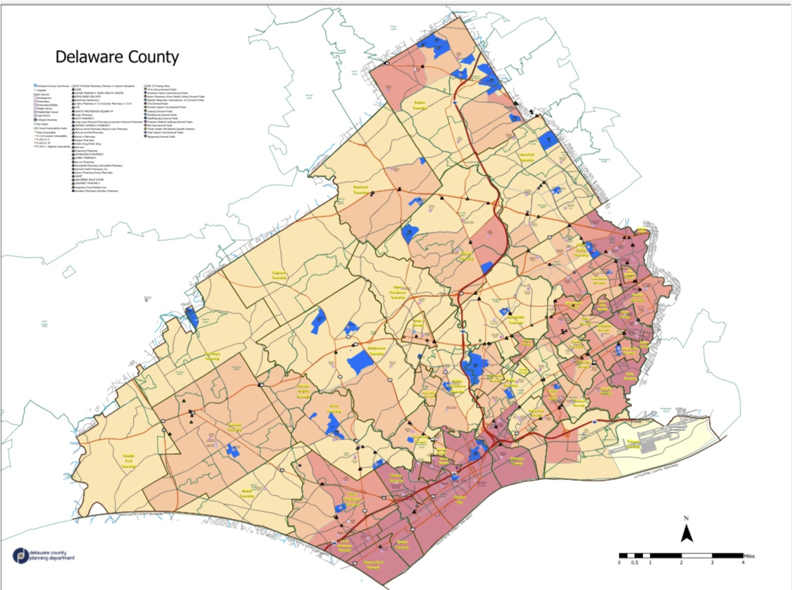
CDC Social Vulnerability Map of Delaware County

Slide 40
Building Community Resiliency through All-hazards Response Planning
Behavioral health mitigation and response
Identifying additional Funding streams
Updating MCM planning to include both short term and long-term responses
Equity planning, engaging whole community
Engaging stakeholder groups and individual volunteers in emergency preparedness, mitigation, response, and recovery.
Using community partners for public health initiatives, related emergency response.
Adding Community POD planning to MCM planning, beyond the OPEN and CLOSED PODs.

Slide 41
Community POD Defined
  Population Served – General Public but focused on specific and generally underserved population groups and/or geographies. Generally done in partnership with another organization that has a preexisting relationship with the population group. May be specifically focused on groups that have a particular need, exposure, etc.
  Planning Status/Requirement – County identifies candidate organizations, sites, and POCs in advance and maintains list(s) thereof. When possible, known and/or potential sites will be surveyed, and at least basic site and facility diagrams provided.
  Scope/Scale – Generally small and short duration dispensing operations in the scale of 50-500 persons. Not designed for sustained operations
    Pill – 50-500
    Injection – 50-500
  Total Staffing Requirement – 5-20
  Leadership Staff – County with support from host
  Medical Staff – County with support from host if available
  General Staff – County with support from host if available

Slide 42
What were your answers to these questions?
Was your jurisdiction prepared for COVID 19?
What was missing in your pre-pandemic planning?
What was your strongest asset at the beginning?
What ways did you produce a non-pharmaceutical response?
A pharmaceutical response?
YES!
Long term vaccination planning, training, exercises. Proper marketing of our MCM plan, and common operating picture.
CCDC

Slide 43
What were your answers to these questions?
Did you use your MCM plan?
What became the backbone of your response?
When did you really start serving the Whole Community?
Did it go well?
What improvements do you plan to make?
How will it go next time?
YES!
Leadership
Homebound – 29 March
69th St – 13 May
Popups – 17 May
Community – 2 June
Yes +/-
COMMUNITY PODs, better marketing, continued education, increase capability and capacity of staff and volunteers
Great!

Slide 44
What were your answers to these questions?
What was your role in the response?
What were your objectives?
What goals did you have to meet those objectives?
What measures were in place to measure your progress?
What success have your celebrated?
BONUS! Would your jurisdiction increase capability and capacity by engaging the whole community in helping provide those services?

Slide 45

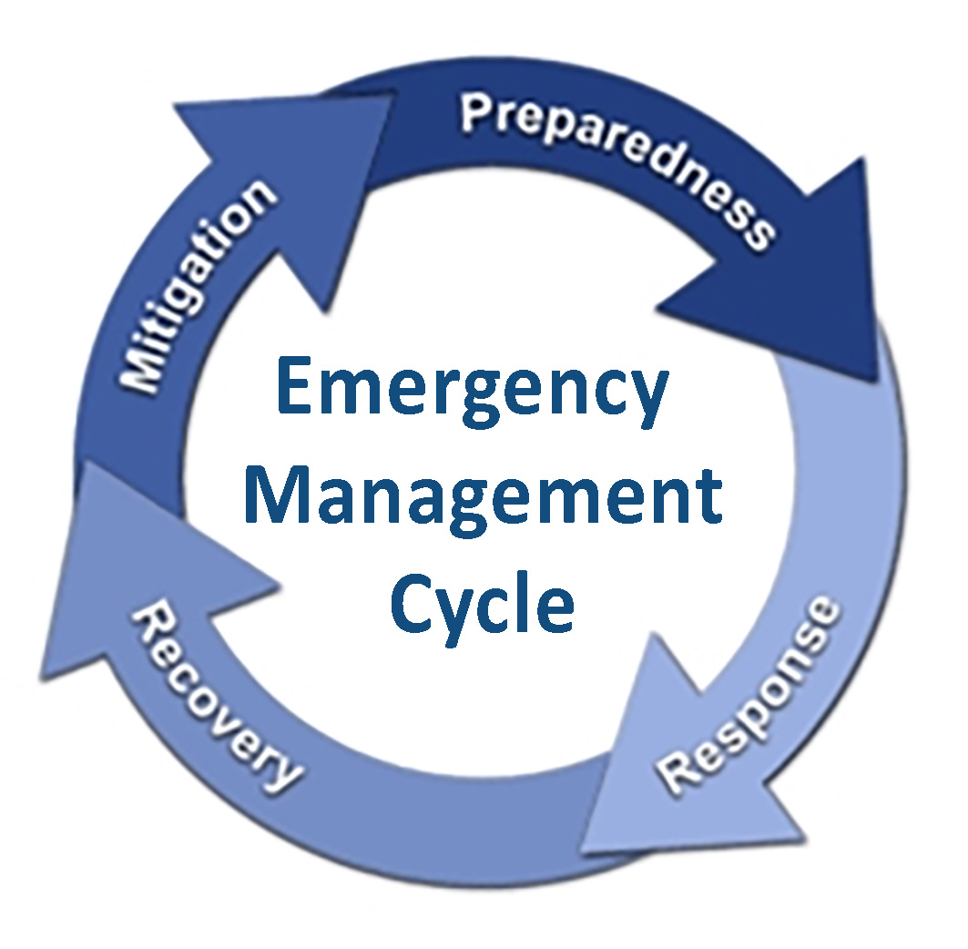

Slide 46
THANK YOU!
Edwin C Kline
215-439-1407 klineE@co.Delaware.pa.us

